Slide 1
INTRINSIC PARAMETER CALIBRATION PROCEDURE FOR A (HIGH-DISTORTION) FISH-EYE LENS CAMERA WITH DISTORTION MODEL AND ACCURACY ESTIMATION
SHISHIR SHAH and J. K. AGGARWAL
Pattern Recognition, Vol. 29, No. 11, pp. 1775-1788, 1996
Date: Jan. 2, 2008
Introducer: Chung-Han Chiang

Slide 2
Abstract
This paper presents a calibration procedure for a fish-eye lens (a high-distortion lens) mounted on a CCD TV camera. The method is designed to account for the differences in images acquired via a distortion-free lens camera setup and the images obtained by a fish-eye lens camera. The calibration procedure essentially defines a mapping between points in the world coordinate system and their corresponding point locations in the image plane. This step is important for applications in computer vision which involve quantitative measurements. The objective of this mapping is to estimate the internal parameters of the camera, including the effective focal length, one-pixel width on the image plane, image distortion center, and distortion coefficients.

Slide 3
The number of parameters to be calibrated is reduced by using a calibration pattern with equally spaced dots and assuming a pin-hole model camera behavior for the image center, thus assuming negligible distortion at the image distortion center. Our method employs a non-linear transformation between points in the world coordinate system and their corresponding location on the image plane. A Lagrangian minimization method is used to determine the coefficients of the transformation. The validity and effectiveness of our calibration and distortion correction procedure are confirmed by application of this procedure on real images.

Slide 4
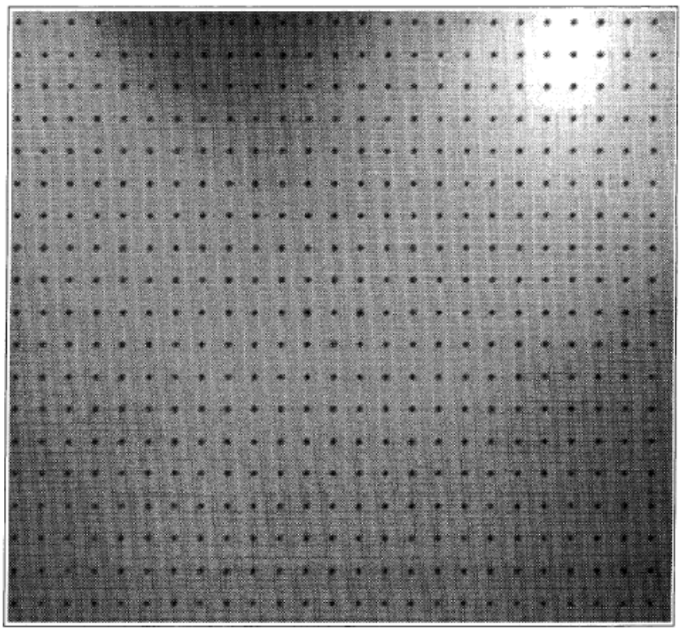
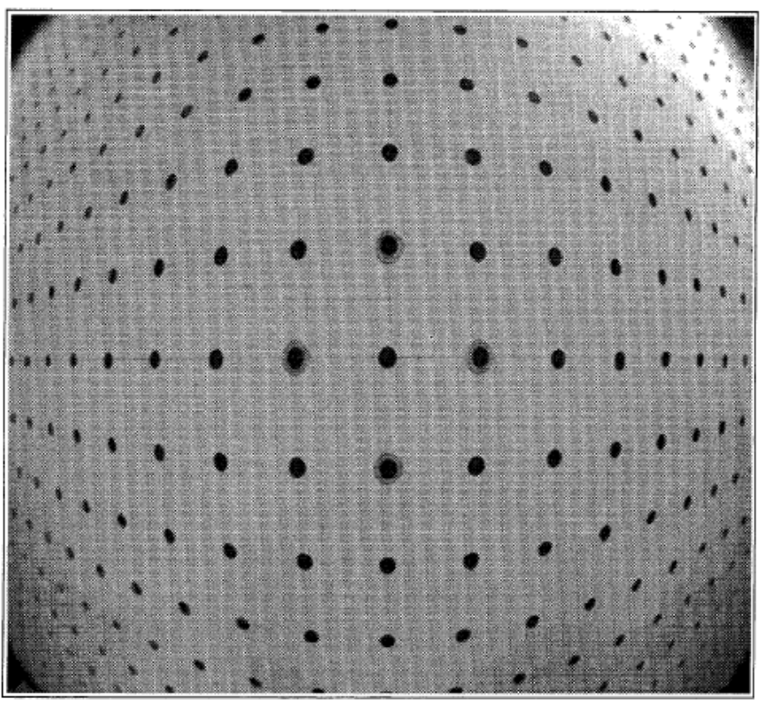
Introduction
(1) Effective focal lengths.
(2) One-pixel width on the image plane.
(3) Optical center.
(4) Distortion coefficients.

Slide 5
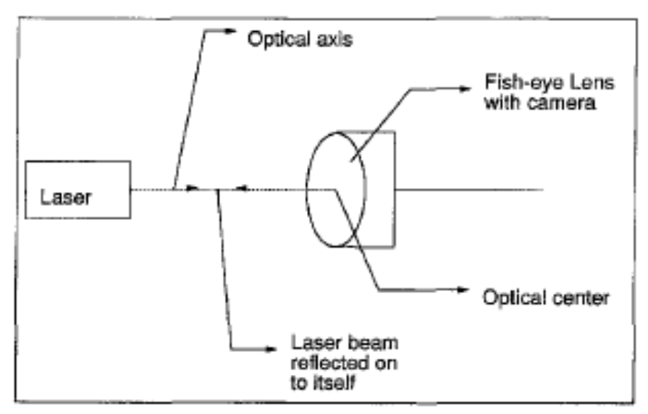
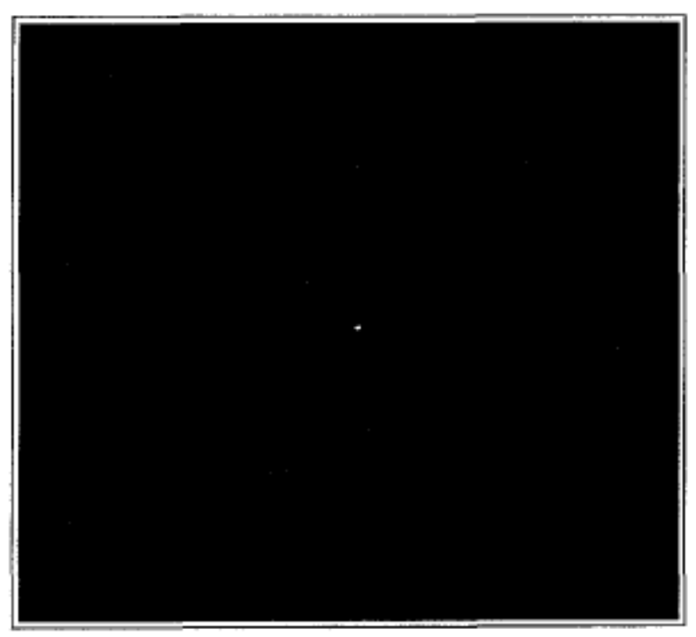
Camera Calibration
1.The optical center
Optical center

Slide 6
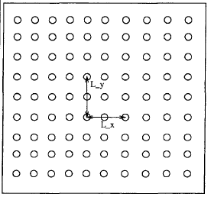
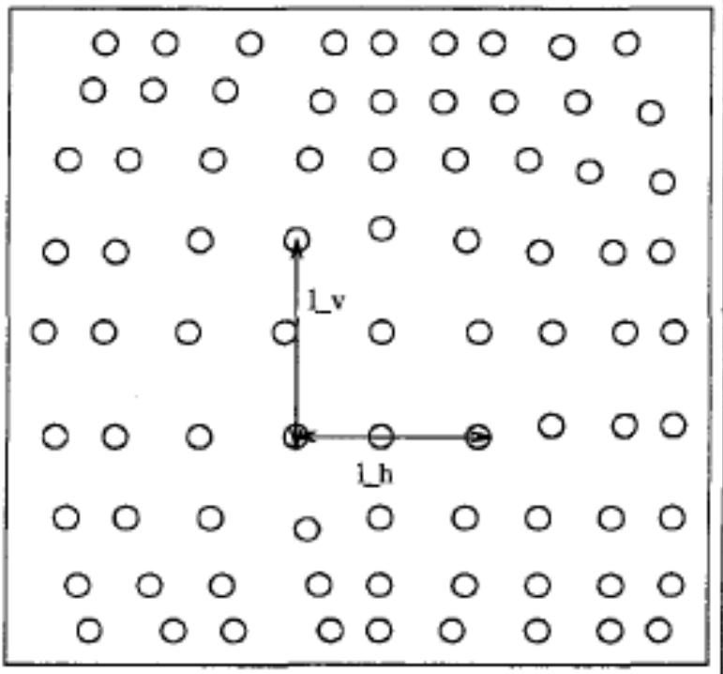
2.The focal length
l_{v} is the distance in pixels between their perspective projections.
L_{y} is defined as the distance between two points in the vertical direction lying close to the center of the pattern
D:Distance between the camera and the pattern is physically measured.
d_{y}: One-pixel height on the image plane determined from the camera specifications.

Slide 7
One-pixel width on the image plane.
l_{h} is the horizontal distance in pixels as seen in the image plane.
L_{x} is the physical distance between the two horizontal points

Slide 8
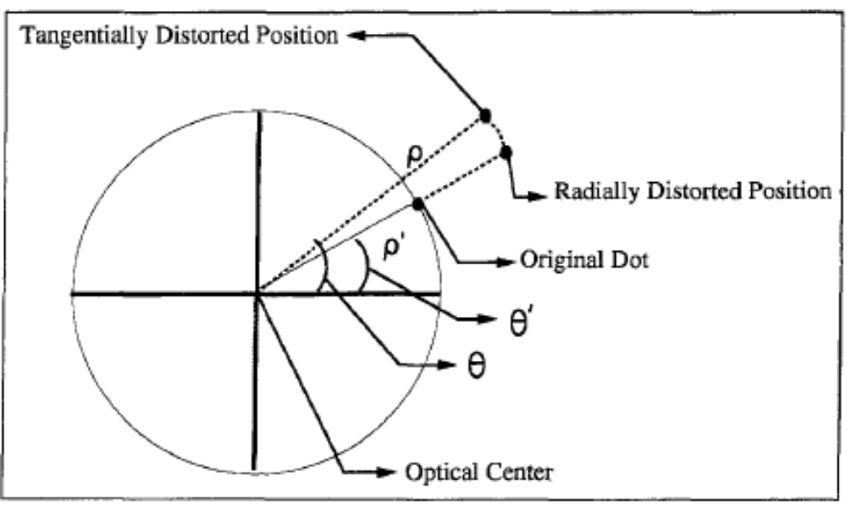
3.Distortion correction procedure

Slide 9
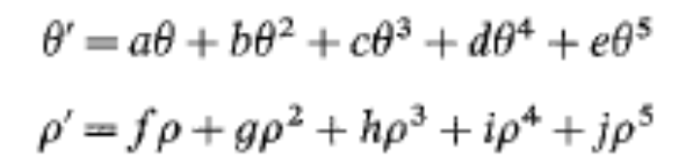
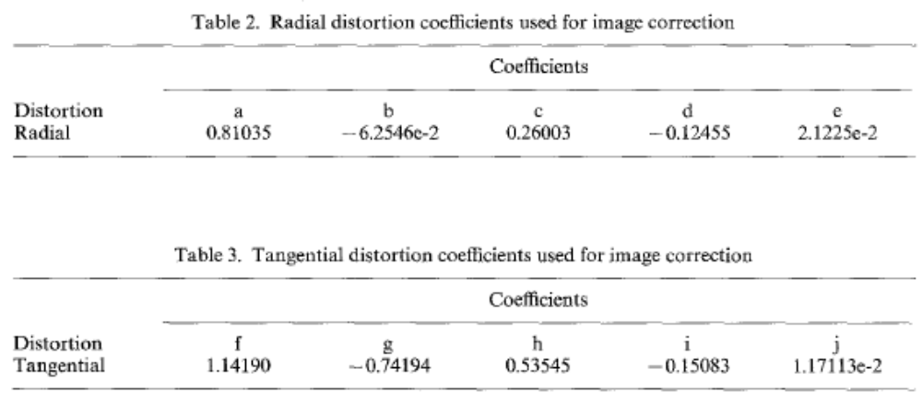
Lagrange minimization. Inverse mapping.

Slide 10
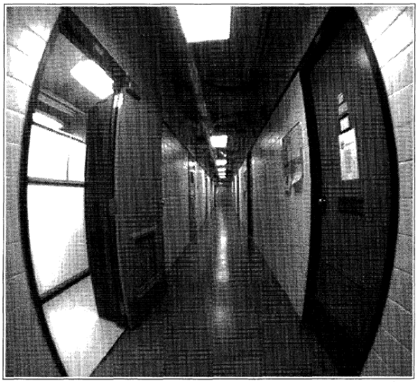
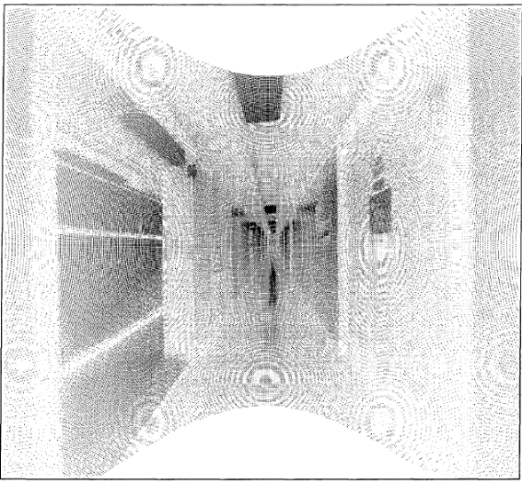
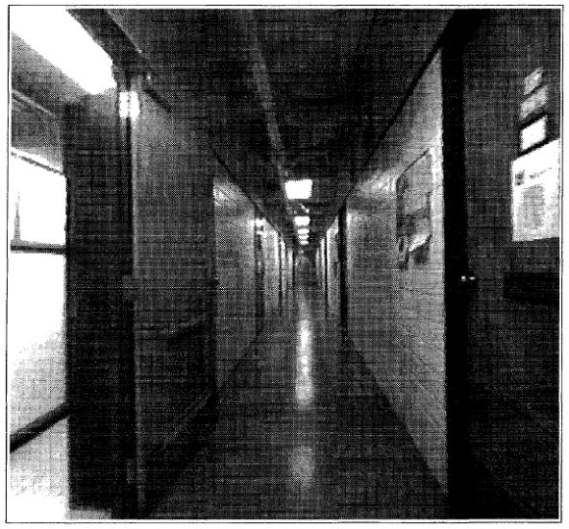
Results and Accuracy
Inverse mapping.

Slide 11
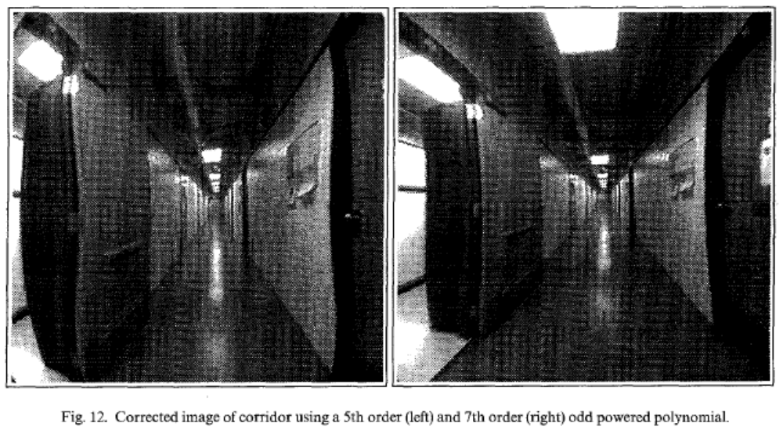

Slide 12
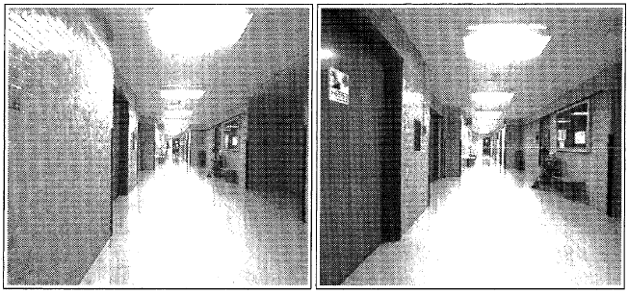


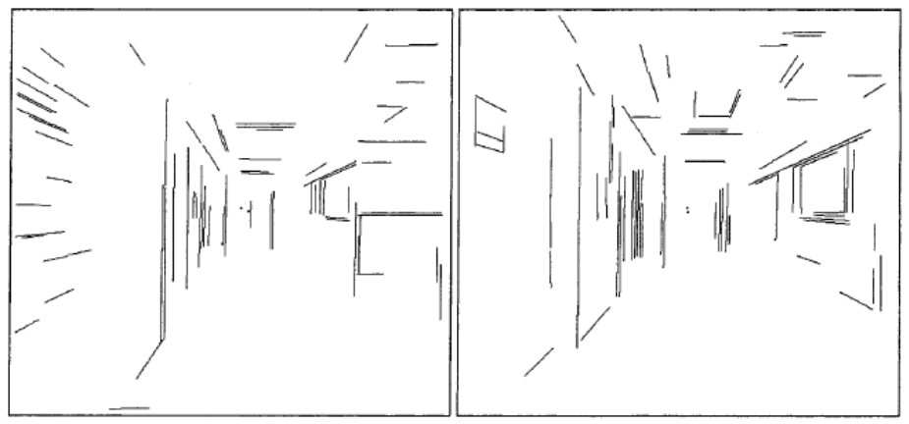
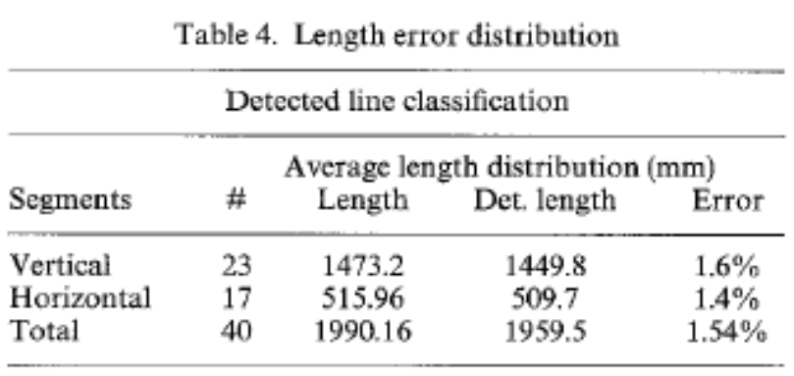
L_{x} and L_{y} is the horizontal and vertical length respectively, of the edge in the real world, Z is the distance of the edge from the lens in the real world
Line segements were detected.

